Slide 1





Final Project
Benefit of Orthogonal Initialization in Deep Linear Networks
電機四 傅敬倫

Slide 2

01
Introduction
Outline
Theorem
02
Implementation
03
Future
04

Slide 3
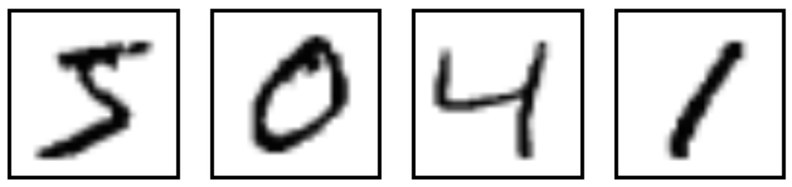
1
Introduction
Classify the image into 10 class ( 0 – 9 number )
Image size : 28 *28
5
0
4
1

Slide 4
1
Dataset
MNIST
Train set : 55000
test set : 12000
It’s a easy task and train set is big enough → epoch = 1

Slide 5
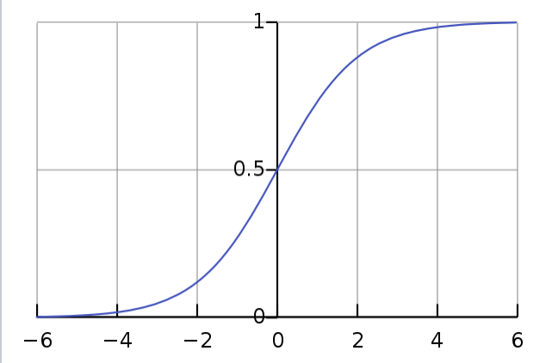
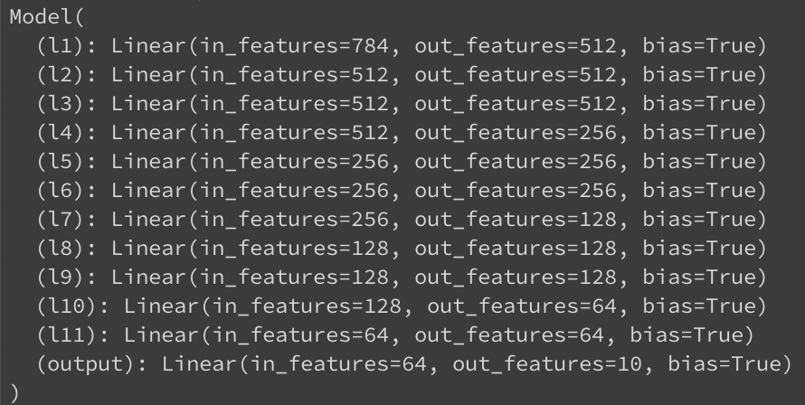
1
Model
Input : N * 784
Output : N * 10
11 linear layers and last Sigmoid

Slide 6
2
Why Deep networks train hard ?
Gradient vanish
Can’t upgrade

Slide 7
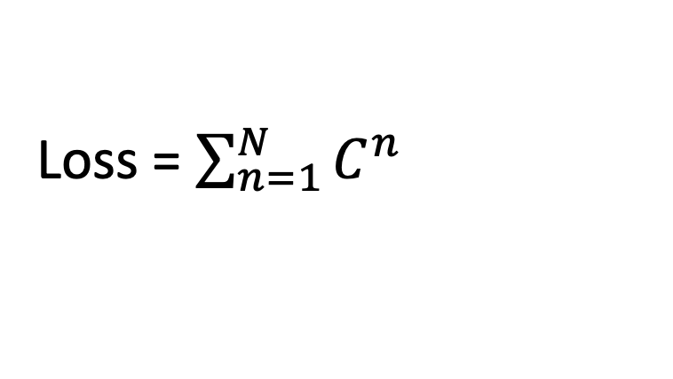
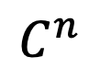
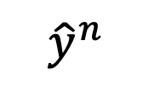
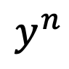
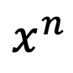
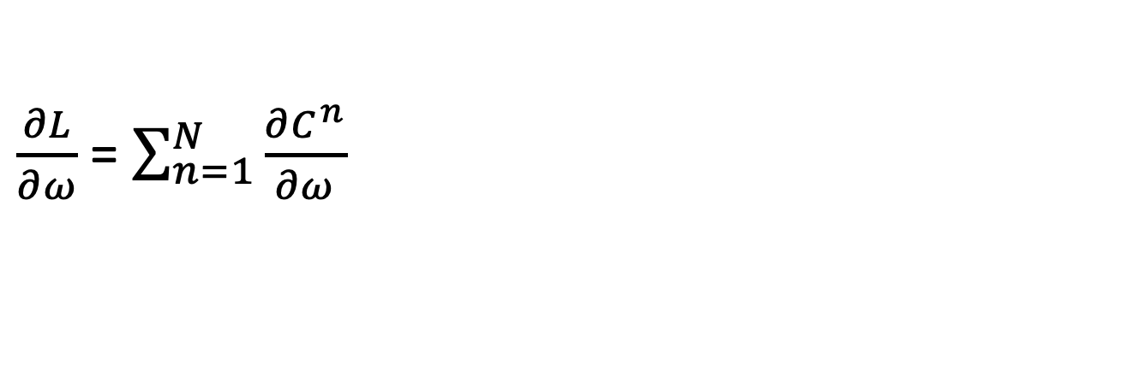
2
Backpropagation
$$x^{n}$$
NN
$$y^{n}$$
$${\hat{y}}^{n}$$
$$C^{n}$$
Loss = $\sum_{n=1}^{N}{C^{n}}$
$\frac{∂L}{∂ω}$ = $\sum_{n=1}^{N}{\frac{∂C^{n}}{∂ω}}$

Slide 8
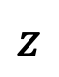
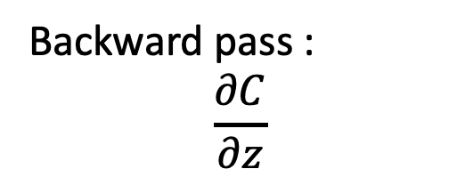
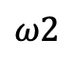

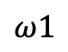



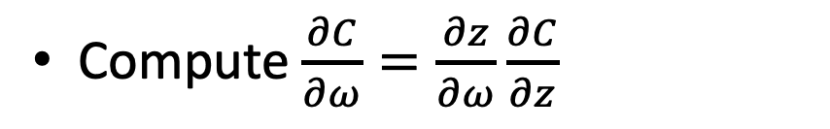
2
Backpropagation
Compute $\frac{∂C}{∂ω}=\frac{∂z}{∂ω}\frac{∂C}{∂z}$
b
$$ω1$$
$$z$$
x1
+
$$∫$$
$$∫$$
y1
$$z=x_{1}ω_{1}+x_{2}ω_{2}+b$$
x2
$$ω2$$
$$∫$$
y2
Forward pass :
$$\frac{∂z}{∂ω}$$
Backward pass :
$$\frac{∂C}{∂z}$$

Slide 9
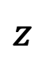

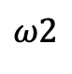

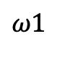
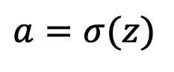

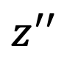
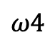
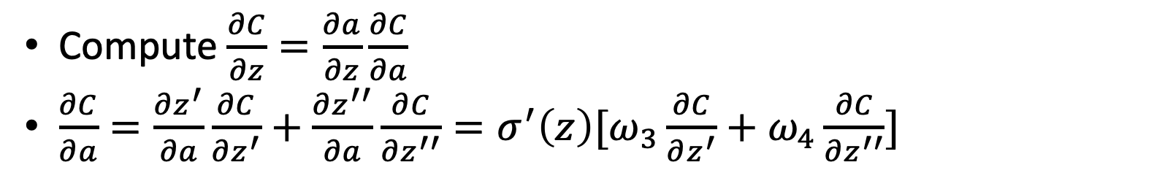
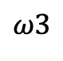
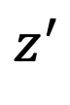
2
Backpropagation
Compute $\frac{∂C}{∂z}=\frac{∂a}{∂z}\frac{∂C}{∂a}$
$\frac{∂C}{∂a}=\frac{∂z^{′}}{∂a}\frac{∂C}{∂z^{′}}+\frac{∂z^{′′}}{∂a}\frac{∂C}{∂z^{′′}}=σ^{′}\left(z\right)[ω_{3}\frac{∂C}{∂z^{′}}+ω_{4}\frac{∂C}{∂z^{′′}}]$
b
$$z^{′}$$
$$ω1$$
$$z$$
a
$$ω3$$
x1
$$∫$$
$$∫$$
+
+
$$a=σ(z)$$
+
$$∫$$
x2
$$ω2$$
$$ω4$$
$$z^{′′}$$

Slide 10
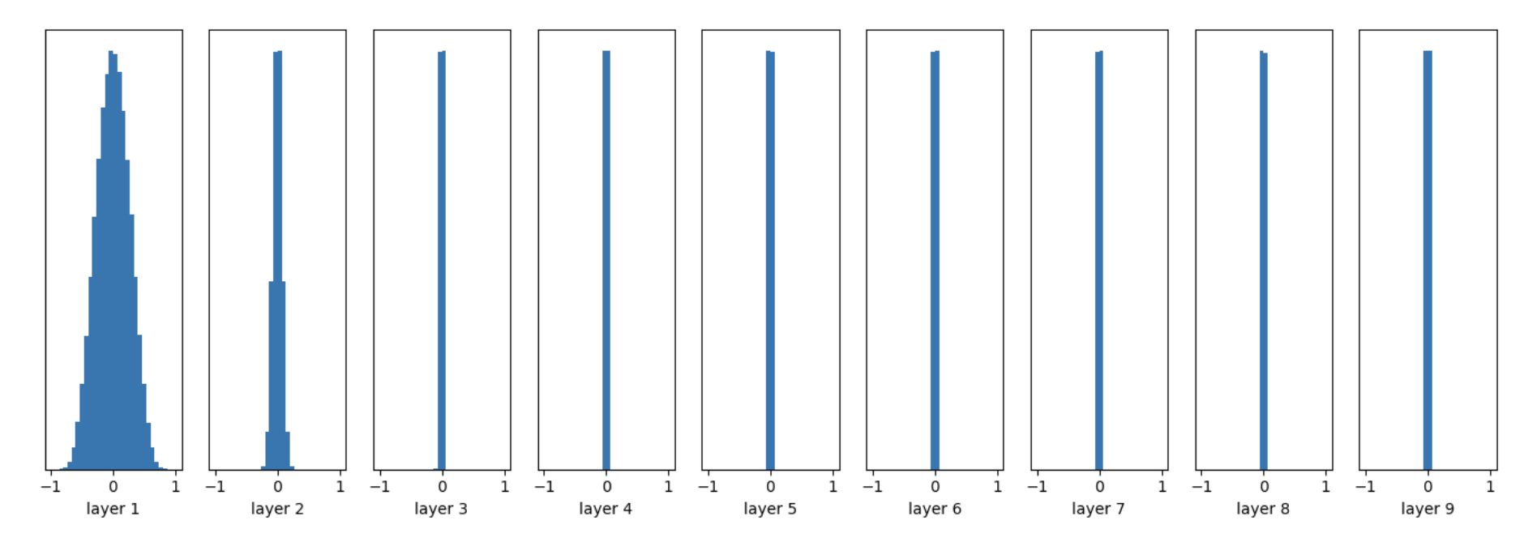
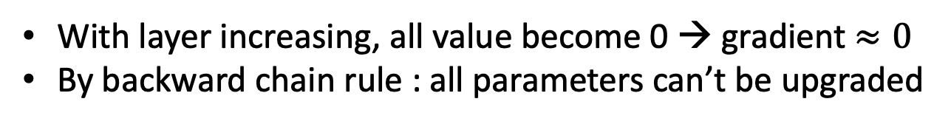
2
Gradient Vanish
With layer increasing, all value become 0 → gradient $≈0$
By backward chain rule : all parameters can’t be upgraded

Slide 11
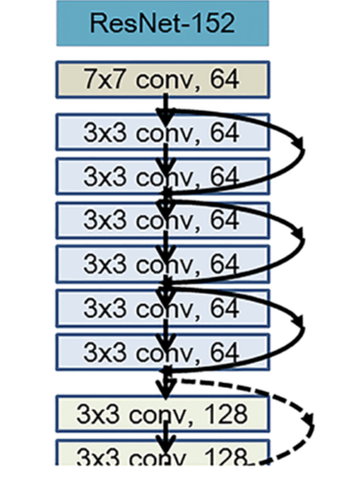
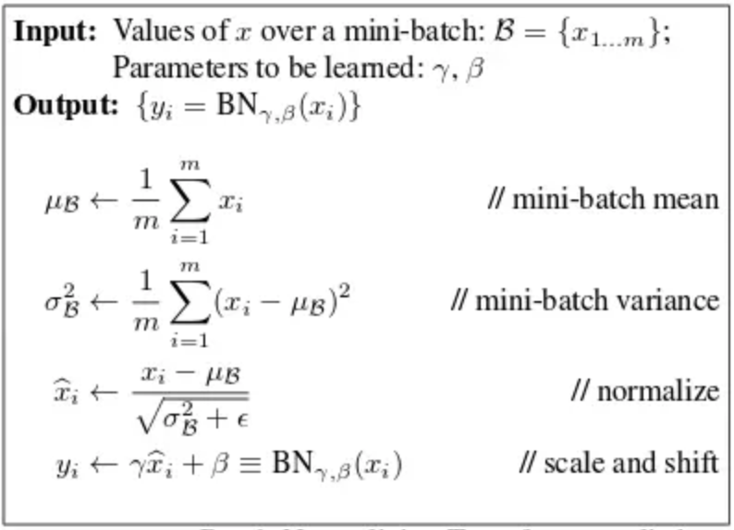
2
Common way
2 common ways to help training Deep Neural Networks
Batch normalization
Skip-connection

Slide 12
3
Why choose Linear ?
Linear is easy to observe loss
nonlinear function may destroy orthogonal matric
Deep > nonlinear

Slide 13
3
Why orthogonal initialization ?
2 common ways to help training Deep Neural Networks
Batch normalization
Skip-connection
Can preserve the norm
$${\left\|WX\right\|}_{2}=X^{T}W^{T}WX=X^{T}X={\left\|X\right\|}_{2}$$
W
X
WX

Slide 14
3
Experience
Two model : Original Model, Orthogonal Model
Epoch : 1
Optimizer : SGD
Learning rate : 0.01
Loss function : CrossEntropy
Model | Accuracy on test set
Original | 10.6%
Orthogonal | 90.6%

Slide 15
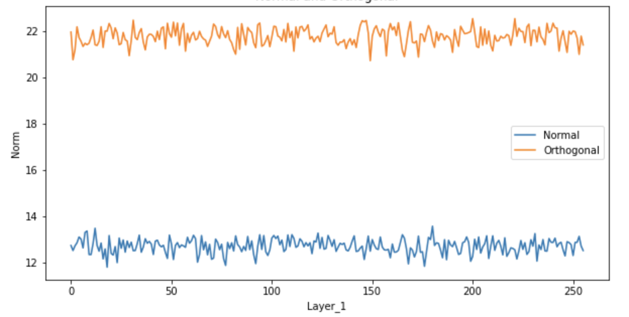
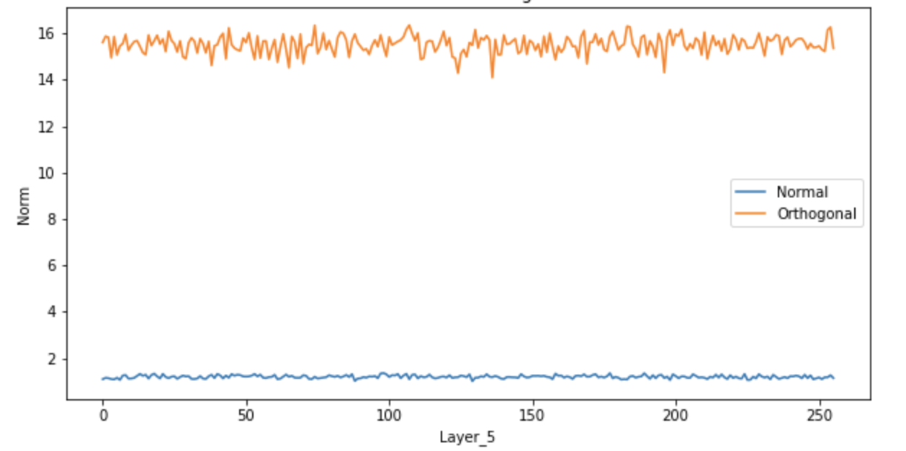
3
Layers
Layer_1
Layer_5

Slide 16
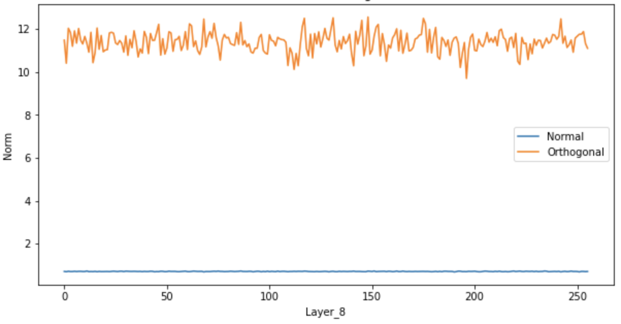
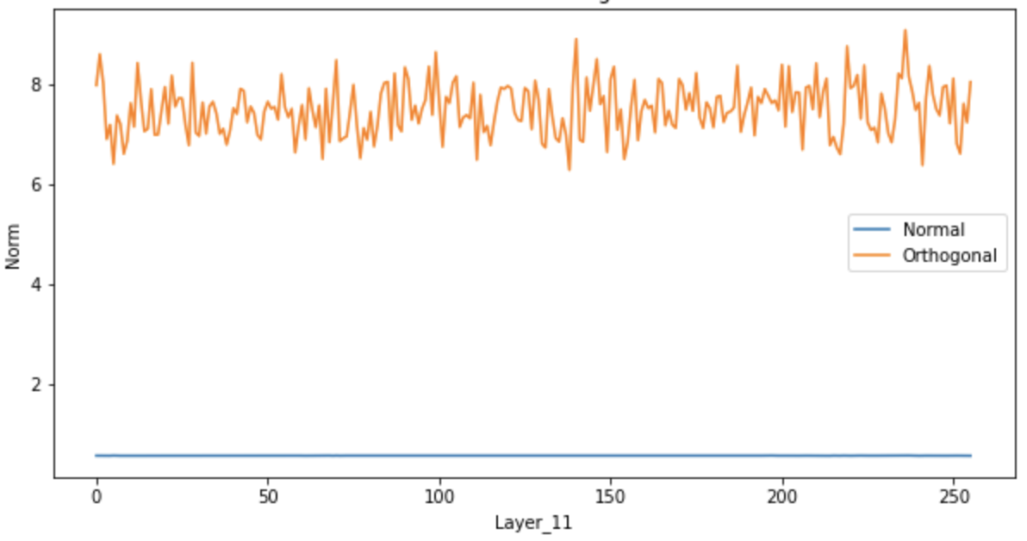
3
Layers
Layer_8
Layer_11

Slide 17
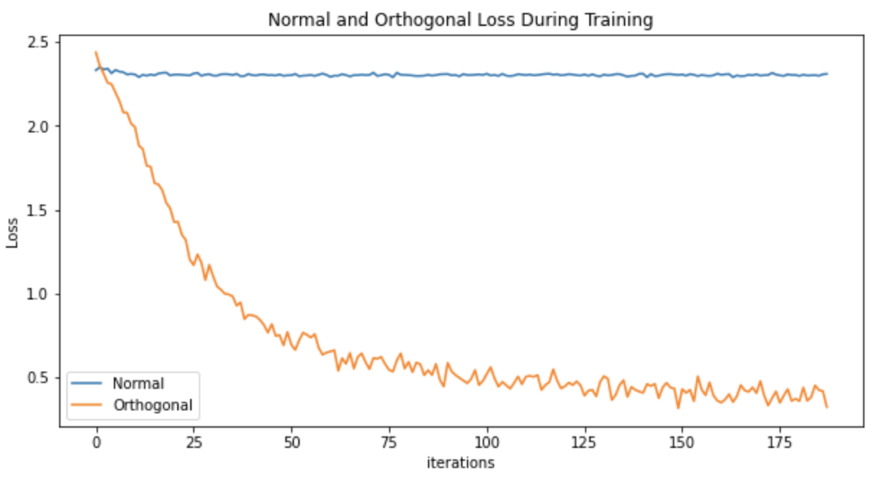
3
Loss

Slide 18
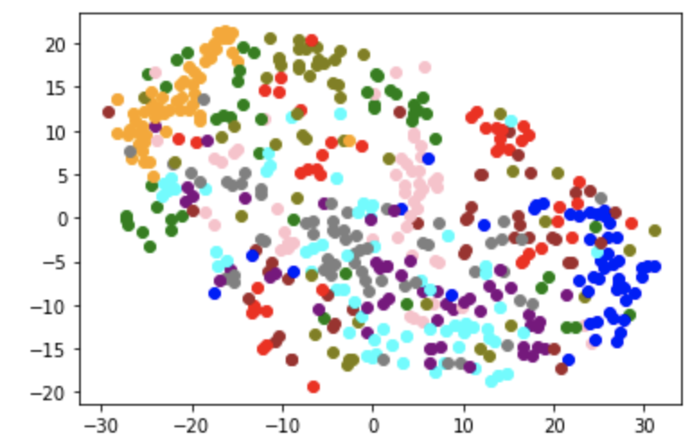
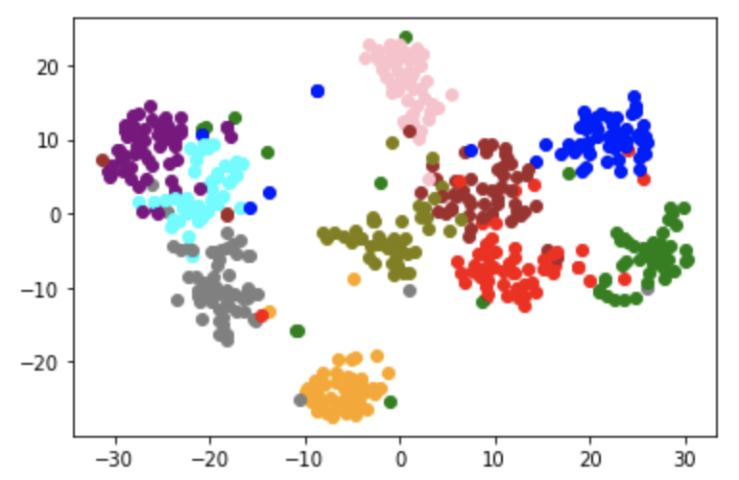
3
t-SNE
Original
Orthogonal

Slide 19
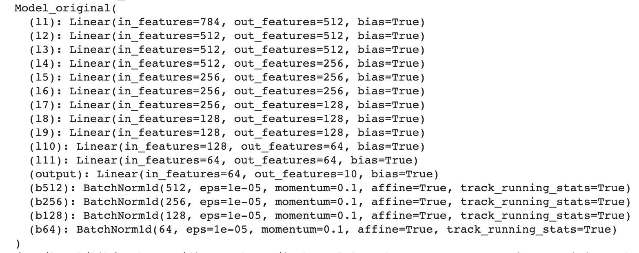
3
Compare with Batch-normalization
Layer1
BN
Layer2
BN

Slide 20
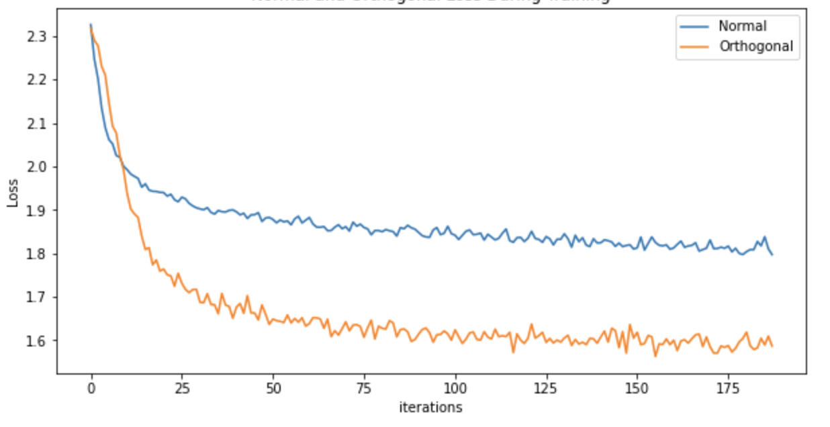
3
Compare with Batch-normalization
Model | Accuracy on test set
Original (with norm) | 83.9%
Orthogonal | 90.6%

Slide 21
3
Conclusion
Model | Accuracy on test set
Original | 10.6%
Original (with norm) | 83.9%
Orthogonal | 90.6%

Slide 22
4
Future works
Non-linear function is a challenge for orthogonal
Not only initialization orthogonal
Loss function can also leading orthogonal

Slide 23
4
Ref
聊一聊深度學習的weight initialization https://zhuanlan.zhihu.com/p/25110150
My code is on my Github : Allen0307
https://github.com/Allen0307/Linear-algebra

Slide 24

Thanks for listening

